Slide 1

Mobile Development Introduction
{mobidev}

Slide 2
What we’ll cover:
Introduction – IDEs (PHP dev environments)
Introduction – Course Outline
ICE
Communication
Money
{mobidev}

Slide 3

ICE:
{mobidev}

Slide 4

Communication:
{mobidev}

Slide 5
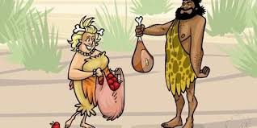
Money:
{mobidev}

